Slide 1
Secure your modular monolith
…by pretending it’s a cat
William Brander // @williambza

Slide 2
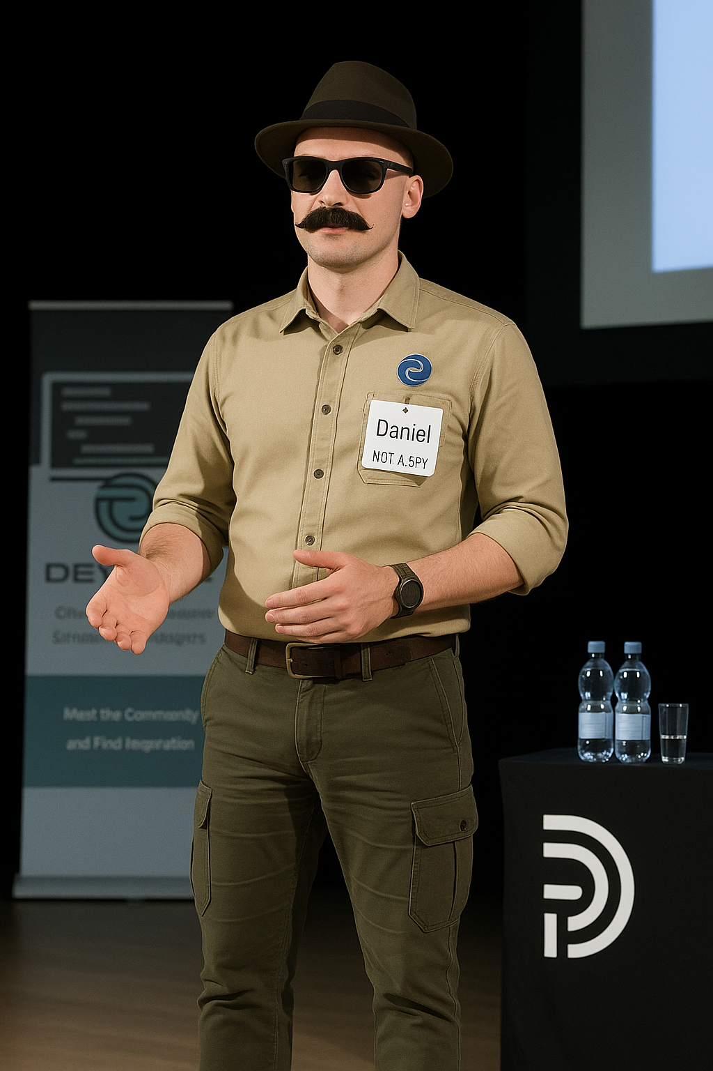
Notes:
Meet Daniel. 12 years at the company. Quiet. Reliable. Always followed the rules — until the day he didn’t."
No one noticed the resignation letter he drafted but never sent.
There’s no end in sight to the late nights he stays logged in.
He has access to everything: production systems, shared secrets, service accounts that haven't been rotated in years.
And the system trusts him — because he’s on the inside.
One script. One call to an internal API that was never supposed to be public. One bad day.
Daniel didn’t hack the system. He just used it exactly as it was built — with too much trust baked in.
This talk isn’t about hackers in hoodies. It’s about the real threat: insiders, legacy assumptions, and systems that trust just a little too easily.
Because in a distributed system, where services and identities span environments, clouds, and continents — trust isn’t a feature. It’s a bug.
My name is William Brander, Let’s talk about how to fix that.

Slide 3
Secure your modular monolith
…by pretending it’s a cat
William Brander // @williambza

Slide 4
Not covering
Covering
Authentication
End-to-end TLS encryption
Token exchanges
Securing databases
Front-end security
Tracking Identity
Basics of Zero-Trust in messaging
Personalization of data
Token expiration
How versioning affects security

Slide 5



Not covering
Covering
Authentication
End-to-end TLS encryption
Token exchanges
Securing databases
Front-end security
Tracking Identity
Basics of Zero-Trust in messaging
Personalization of data
Token expiration
How versioning affects security
Cat memes

Slide 6
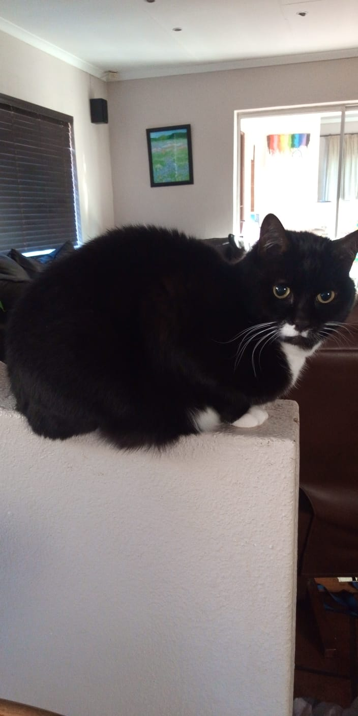
Introducing: Butterbean
Nickname: Butt
Likes: Food
Dislikes: Everything except food
Hobbies: Sleeping, annoying me.
Favourite person: Not me. Not you either.

Slide 7
Modular monolith
API Gateway
Module A
Module B
Module C
Client
Mediator bus
Message broker

Slide 8
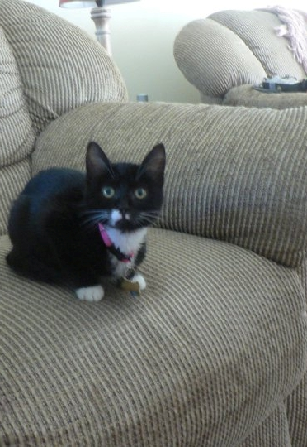
Modular monolith
Kitten
Safe room
Toys
Food
Module C
API Gateway
Module A
Module B
Litter box
Name
Mediator bus
Skritches, play, and cuddles
Rest of the house

Slide 9

Let’s let our monolith out
Source: Rene Nijkamp
Notes:
This is a cat named Jan

Slide 10
Modular monolith
API Gateway
Module A
Module B
Module C
Client
Mediator bus
Message broker

Slide 11
public class ChargeCreditCard
{
public string CreditCardNumber;
public string CVV;
public string ExpiryDate;
public string CardHolderName;
}
public class ChargeCreditCard
{
public string CreditCardNumber;
public string CVV;
public string ExpiryDate;
public string CardHolderName;
public string UserId;
}

Slide 12
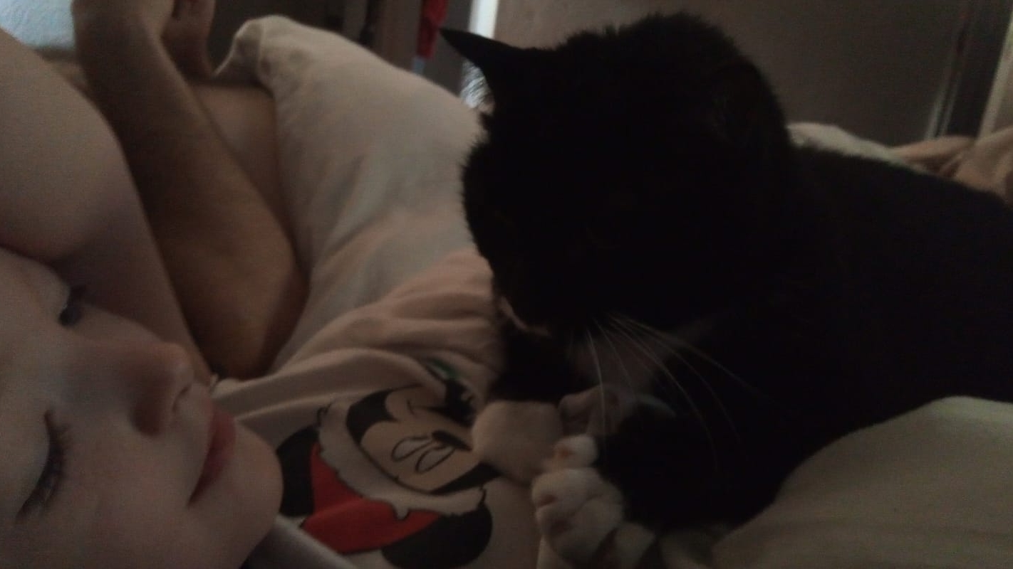

Slide 13
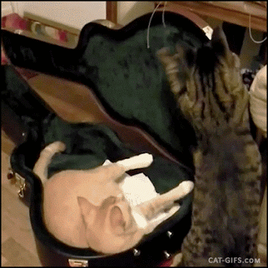

Slide 14
Include the user id as part of the message from the beginning
1.
even when it’s still a monolith

Slide 15

Authorization

Slide 16

Commands
Commands
Module C
Sent to a specific logical owner
Used to make a request
Can originate from many places

Slide 17
Events
Events
Module C
Published by a specific logical owner
Used to notify that something has occurred
Can go to many places

Slide 18
Modular monolith
API Gateway
Module A
Module B
Module C
Client
Mediator bus
Message broker

Slide 19
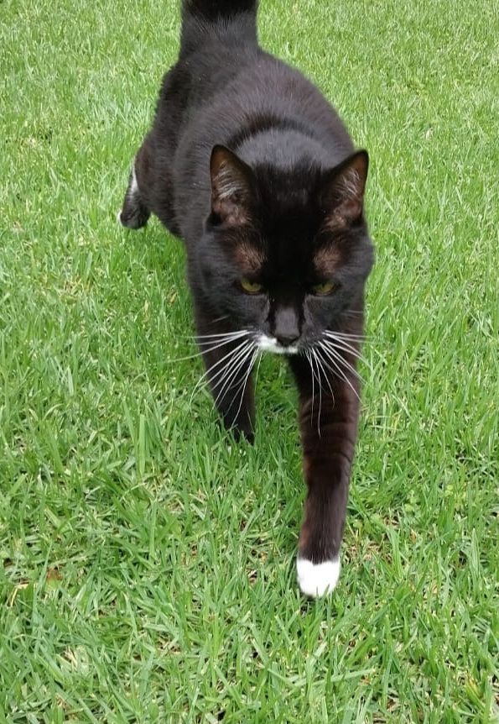
Simplified Modular monolith
Sending commands
Module A
Module C
Client
Mediator bus
Message broker

Slide 20
API Gateway
Module A
Module B
Module C
Module D
Module E
Module F
Module …
Mediator bus
Message broker

Slide 21
public class SigningBehavior<TRequest, TResponse> : IPipelineBehavior<TRequest, TResponse>
where TRequest : ContextualRequest<TResponse>
{
public Task<TResponse> Handle(TRequest request, RequestHandlerDelegate<TResponse> next, CancellationToken token)
{
using (var hmac = new HMACSHA256())
{
hmac.Key = request.Items["SenderModule"].Key; // Get from a vault somewhere
var hashBytes = hmac.ComputeHash(new ReadOnlyStream(request));
var hashBase64String = Convert.ToBase64String(hashBytes);
request.Items["X-Message-Signature"] = hashBase64String;
}
return next;
}
}

Slide 22
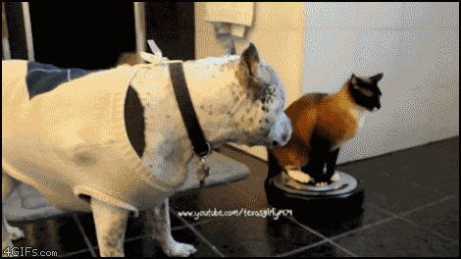

Slide 23


Slide 24
Sign outgoing messages in middleware
2.
and validate them when processing

Slide 25
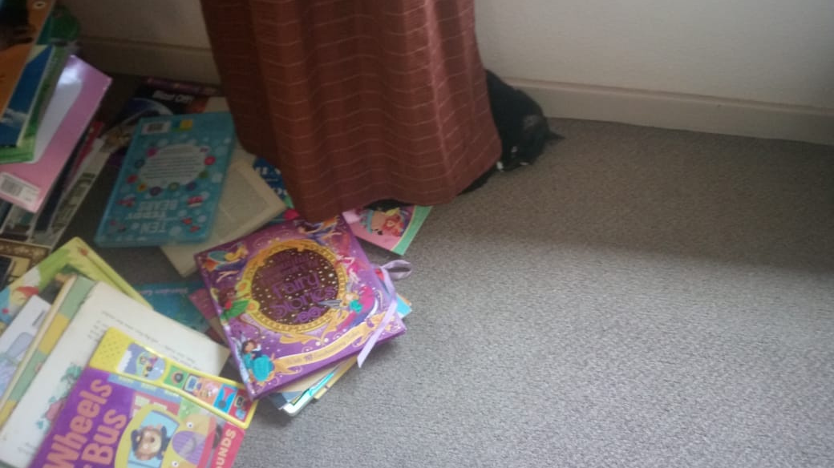

Slide 26

Reading messages
Module A
Module C
Client
Mediator bus
Message broker
Notes:
key encrypt by Royyan Wijaya from <a href="https://thenounproject.com/browse/icons/term/key-encrypt/" target="_blank" title="key encrypt Icons">Noun Project</a> (CC BY 3.0)

Slide 27
public Task<TResponse> Handle(TRequest request, RequestHandlerDelegate<TResponse> next, …)
{
using (Aes aesAlg = Aes.Create())
{
aesAlg.Key = request.PrivateKey; // Get from a vault somewhere
aesAlg.IV = request.IV;
// Create an encryptor to perform the stream transform.
ICryptoTransform encryptor = aesAlg.CreateEncryptor(aesAlg.Key, aesAlg.IV);
// Create the streams used for encryption.
using (MemoryStream msEncrypt = new())
{
using (CryptoStream csEncrypt = new(msEncrypt, encryptor, CryptoStreamMode.Write))
{
using (StreamWriter swEncrypt = new(csEncrypt))
{
var objectStream = new ReadOnlyStream(request);
// Write all data to the stream.
objectStream.WriteTo(swEncrypt);
}
encrypted = msEncrypt.ToArray();
}
}
request.Body = encrypted;
}
return next;
}

Slide 28
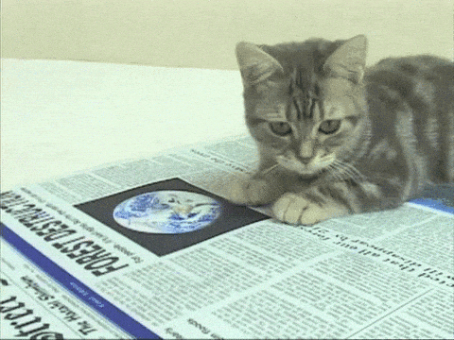

Slide 29
Assume that a bad actor is already inside your network
3.

Slide 30
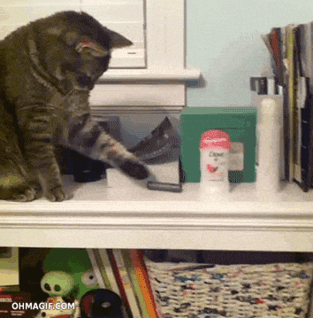

Slide 31


Slide 32
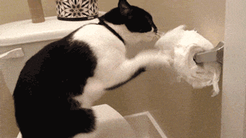

Slide 33
Discarding messages
Module A
Module C
Client
Mediator bus
Message broker
Notes:
key encrypt by Royyan Wijaya from <a href="https://thenounproject.com/browse/icons/term/key-encrypt/" target="_blank" title="key encrypt Icons">Noun Project</a> (CC BY 3.0)

Slide 34
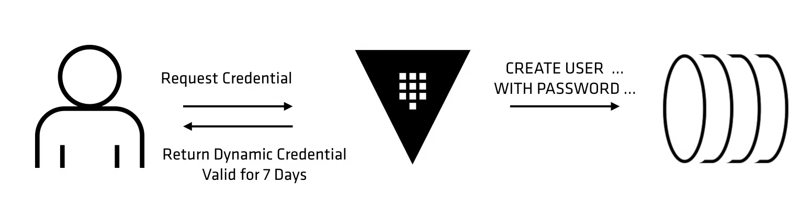
Rotate security credentials
Notes:
key encrypt by Royyan Wijaya from <a href="https://thenounproject.com/browse/icons/term/key-encrypt/" target="_blank" title="key encrypt Icons">Noun Project</a> (CC BY 3.0)

Slide 35
Rotate security credentials
// Create user
var password = GenerateRandomStrongPassword();
var response = await httpClient.PutAsync($"{managementApiUrl}/api/users/{username}",
new StringContent($"{{password:\"{password}\"}}"));
response.EnsureSuccessStatusCode();
// Set permissions
var permissionsResponse = await httpClient.PutAsync($"{managementApiUrl}/api/permissions/vhost/{username}",
new StringContent("{write, read}"));
permissionsResponse.EnsureSuccessStatusCode();
return new UserCredentials
{
Username = username,
Password = password
};
Notes:
key encrypt by Royyan Wijaya from <a href="https://thenounproject.com/browse/icons/term/key-encrypt/" target="_blank" title="key encrypt Icons">Noun Project</a> (CC BY 3.0)

Slide 36
Rotate security credentials
// Change the password for a user from the “pool”
var password = GenerateRandomStrongPassword();
var response = await httpClient.PutAsync($"{managementApiUrl}/api/users/{username}",
new StringContent($"{{password:\"{password}\"}}"));
response.EnsureSuccessStatusCode();
return new UserCredentials
{
Username = username,
Password = password
};
Notes:
key encrypt by Royyan Wijaya from <a href="https://thenounproject.com/browse/icons/term/key-encrypt/" target="_blank" title="key encrypt Icons">Noun Project</a> (CC BY 3.0)

Slide 37
Rotate security credentials
public static async Task SendMessageWithSasFromKeyVaultAsync()
{
TimeSpan ttl = TimeSpan.FromMinutes(1);
string sasKey = await GetSecretFromKeyVaultAsync("key-vault-url", "asb-sas-key");
string resourceUri = $"https://{fullyQualifiedNamespace}/{queueName}";
string token = GenerateSasToken(resourceUri, "sas-policy", sasKey, ttl);
var client = new ServiceBusClient(fullyQualifiedNamespace, new AzureSasCredential(token));
var sender = client.CreateSender(queueName);
await sender.SendMessageAsync(new ServiceBusMessage(“Message using SAS token valid for 1 minute"));
}
Notes:
key encrypt by Royyan Wijaya from <a href="https://thenounproject.com/browse/icons/term/key-encrypt/" target="_blank" title="key encrypt Icons">Noun Project</a> (CC BY 3.0)

Slide 38
Use Dynamic credentials
5.

Slide 39
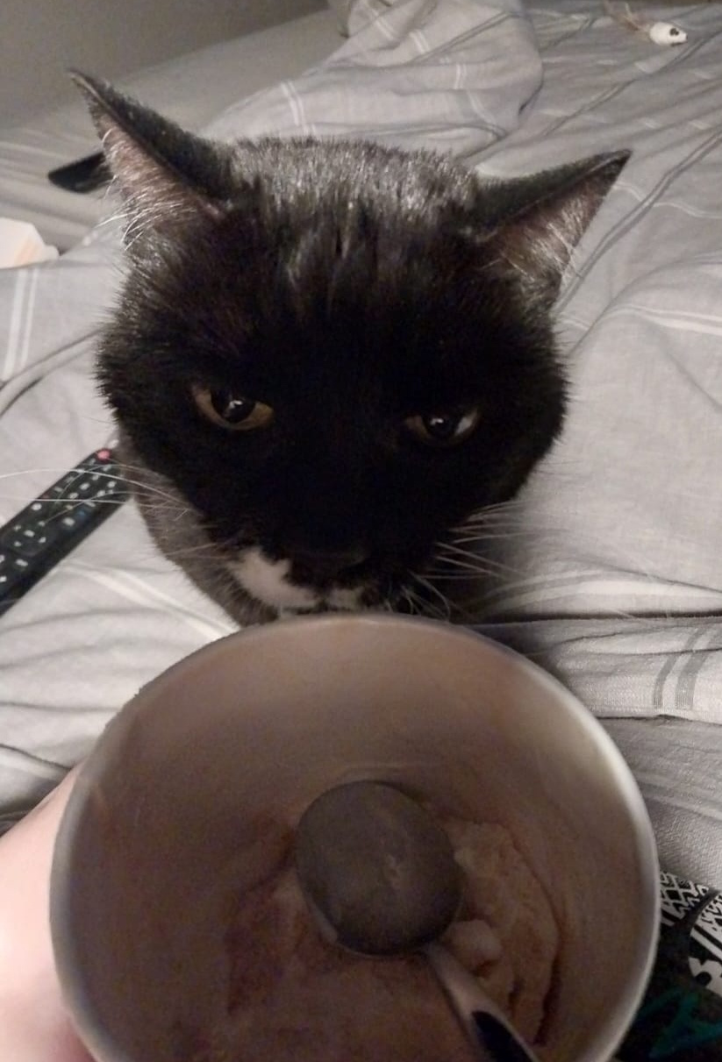
Personalization

Slide 40
public class OrderShipped
{
public string OrderId;
public string BinPackId;
public string RecipientName;
public string Address;
public string ContactNumber;
public string EmailAddress;
public string UserToken;
}
public class OrderShipped
{
public string OrderId;
public string BinPackId;
public string RecipientName;
[Sensitive]
public string Address;
[Sensitive]
public string ContactNumber;
[Sensitive]
public string EmailAddress;
public string UserToken;
}

Slide 41
public Task<TResponse> Handle(TRequest request, RequestHandlerDelegate<TResponse> next, …)
{
var propertiesToEncrypt = from property in typeof(request).GetProperties()
where typeof(EncryptedString).IsAssignableFrom(property.PropertyType);
// Get from a vault somewhere
var privateKey = request.PrivateKey;
var iv = request.IV;
foreach (var property in propertiesToEncrypt)
{
var encryptedValue = EncryptString(property.GetValue(request).ToString(), privateKey, iv);
property.SetValue(request, Convert.ChangeType(encryptedValue, property.PropertyType));
}
return next;
}

Slide 42
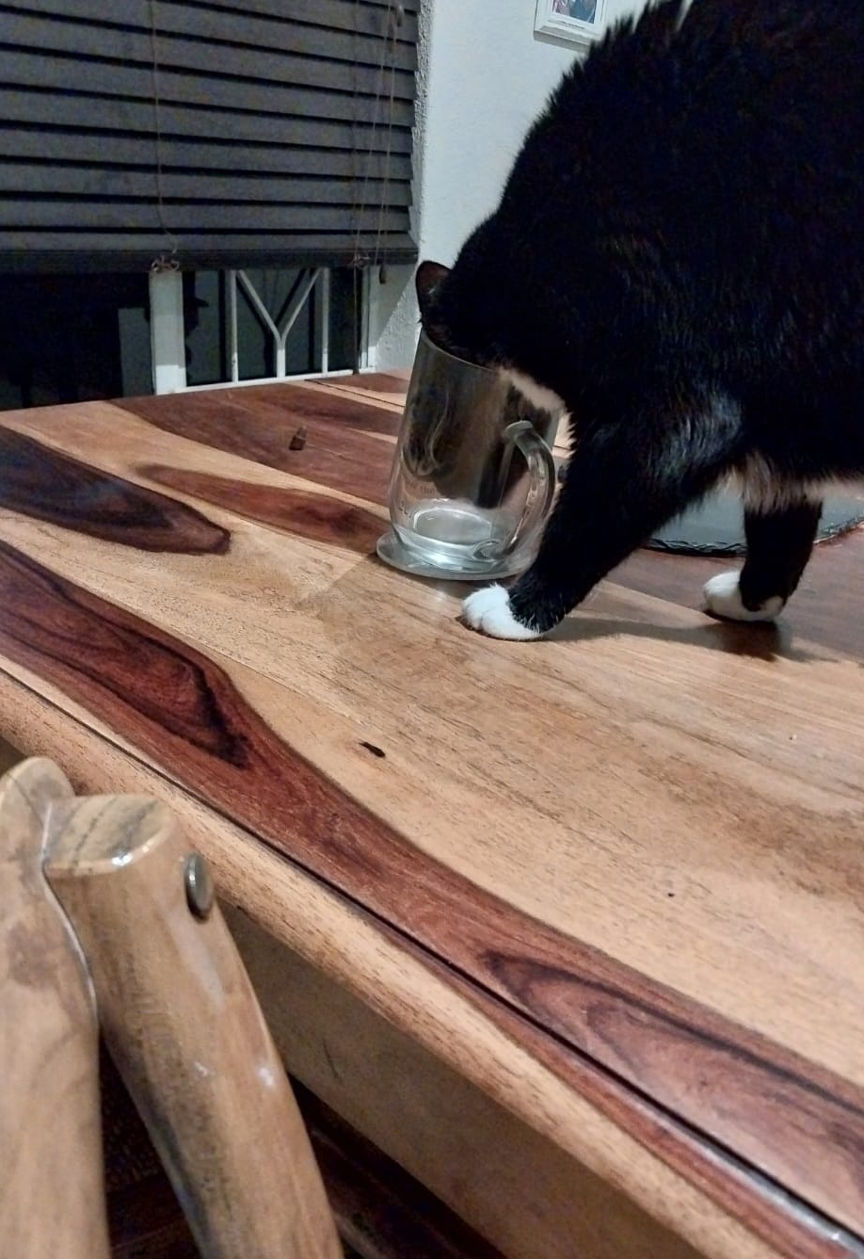
public class ShipOrder
{
public string OrderId;
public string BinPackId;
public string RecipientName;
[Sensitive(Roles=["Dispatch"])]
public string Address;
[Sensitive(Roles=["Dispatch"])]
public string ContactNumber;
[Sensitive(Roles=["Dispatch", "CustomerServices"])]
public string EmailAddress;
public string UserToken;
}

Slide 43
Make sure that sensitive data is only readable by those allowed
4.

Slide 44
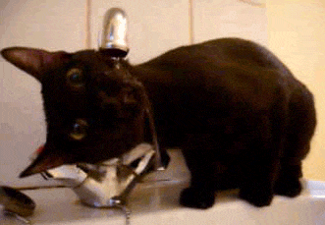

Slide 45
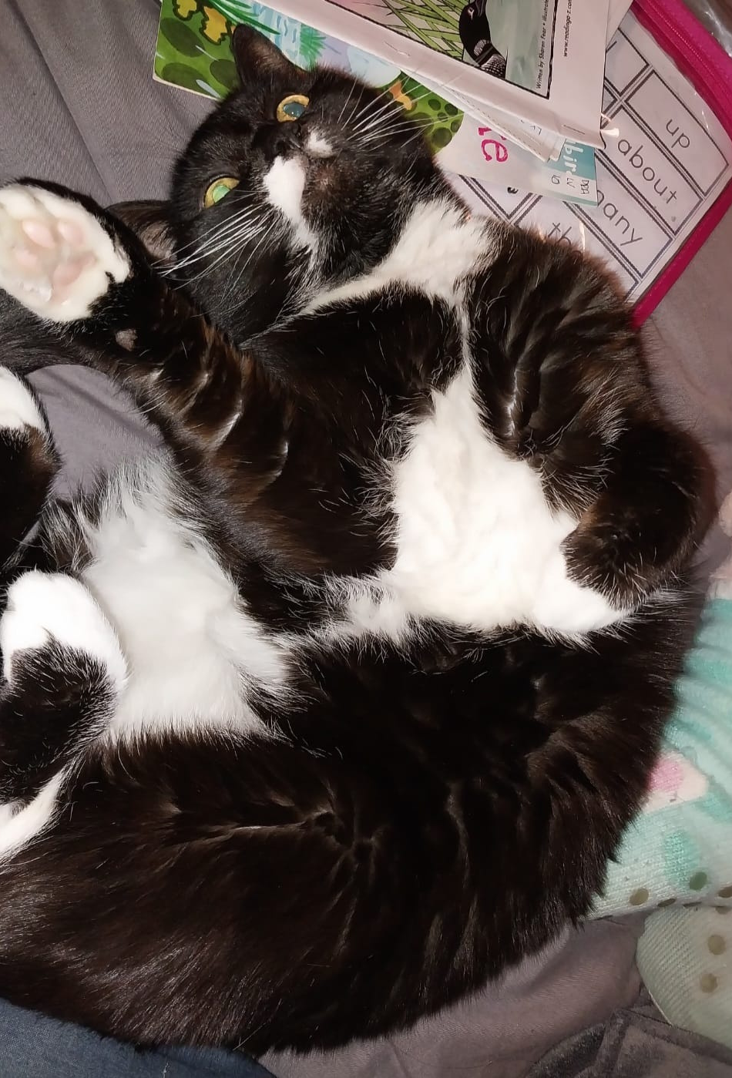
Token Expiration

Slide 46
Token expiration
Module A
Module C
Client
Mediator bus
Message broker

Slide 47
Three options for JWT expiry:
Forward identity
Token exchange
Custom data structure
*or token refresh
https://cheatsheetseries.owasp.org/cheatsheets/Microservices_Security_Cheat_Sheet.html#identity-propagation-existing-patterns

Slide 48
Forwarding identity
public class ChargeCreditCard
{
public string CreditCardNumber;
public string CVV;
public string ExpiryDate;
public string CardHolderName;
public string UserId;
}
Module A
Module C
Client
Mediator bus
Message broker

Slide 49
Custom data structure
public class UserIdentity
{
public string UserName;
public string[] Claims;
public byte[] Hash;
}
Module A
Module C
Client
Mediator bus
Message broker

Slide 50
Token exchange
* Longer expiry
* Has a hash of the message
INCLUDING the MessageId
* Could be a Refresh token
Module A
Module C
Client
Mediator bus
Message broker

Slide 51
Be aware that tokens could expire before the message gets processed
5.

Slide 52


Slide 53
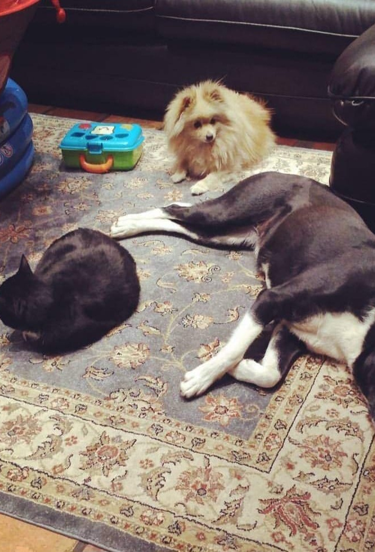
When things change…

Slide 54
Version changes
public class ChargeCreditCard
{
public string CreditCardNumber;
public string CVV;
public string ExpiryDate;
public string CardHolderName;
public string UserId;
}
public class ChargeCreditCard
{
[Sensitive(Roles=["Billing"])]
public string CreditCardNumber;
public string CVV;
public string ExpiryDate;
public string CardHolderName;
public string UserId;
}
Module A
Module C
Client
Mediator bus
Message broker
Notes:
key encrypt by Royyan Wijaya from <a href="https://thenounproject.com/browse/icons/term/key-encrypt/" target="_blank" title="key encrypt Icons">Noun Project</a> (CC BY 3.0)

Slide 55
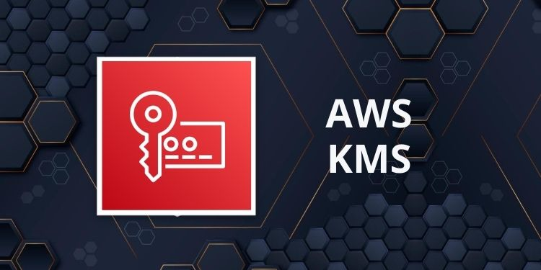


API Gateway
Module A
Module B
Module C
Module D
Module E
Module F
Module …
Mediator bus
Message broker

Slide 56


Slide 57
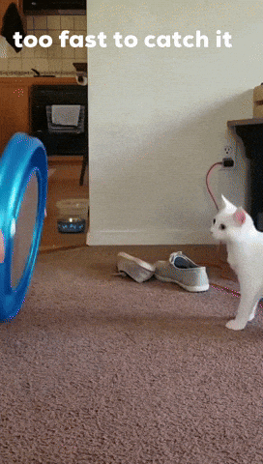

Slide 58
Your middleware should be able to decrypt using different keys
6.

Slide 59
Recap
Include Identity
Sign
Encrypt messages
Include identity even when still a monolith
Make sure your middleware can easily sign and validate each message
Assume that bad actors already have access to your broker when scaling out
Allow Partial Encryption
Plan for Token Expiration
Use a key vault
Using partial message encryption allows you to secure sensitive data to limit who can see what information
Be aware that once scaled out, your messages may only be processed much later
Makes key rotation really easy

Slide 60
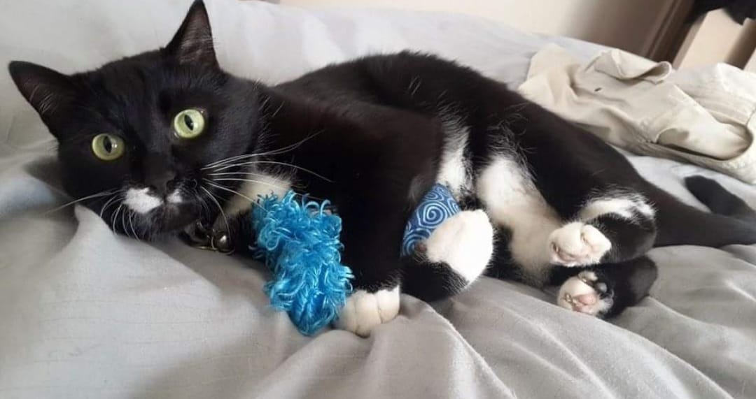

Slide 61
Thanks!
@williambza

Slide 62
Resources
https://github.com/jbogard/MediatR/
https://cloudsecurityalliance.org/artifacts/zero-trust-principles-v-1-1
https://cheatsheetseries.owasp.org/cheatsheets/Microservices_Security_Cheat_Sheet.html#using-a-data-structure-signed-by-a-trusted-issuer

Slide 63
Instructions for use
If you have a free account, in order to use this template, you must credit Slidesgo by keeping the Thanks slide. Please refer to the next slide to read the instructions for premium users.
As a Free user, you are allowed to:
Modify this template.
Use it for both personal and commercial projects.
You are not allowed to:
Sublicense, sell or rent any of Slidesgo Content (or a modified version of Slidesgo Content).
Distribute Slidesgo Content unless it has been expressly authorized by Slidesgo.
Include Slidesgo Content in an online or offline database or file.
Offer Slidesgo templates (or modified versions of Slidesgo templates) for download.
Acquire the copyright of Slidesgo Content.
For more information about editing slides, please read our FAQs or visit our blog:
https://slidesgo.com/faqs and https://slidesgo.com/slidesgo-school

